Slide 1
Data Structures Chapter 2-4
Performance Analysis
Big-O Notation
Big-O Properties
Growth Rates

Slide 2
프로그램의 성능을 비교하기 위한 방법을 배우고
예시를 통해 적용할 수 있다

Slide 3
그러므로 나의 사랑하는 자들아 너희가 나 있을 때 뿐 아니라 더욱 지금 나 없을 때에도 항상 복종하여 두렵고 떨림으로 너희 구원을 이루라 (Continue to work out your salvation with fear and trembling.) 빌2:12
나는 인애를 원하고 제사를 원하지 아니하며 번제보다 하나님을 아는 것을 원하노라 (호6:6)
하나님은 모든 사람이 구원을 받으며 진리를 아는데에 이르기를 원하시느니라 (딤전2:4)
그런즉 너희가 먹든지 마시든지 무엇을 하든지 다 하나님의 영광을 위하여 하라 (고전10:31)

Slide 4
Agenda & Reading
Performance Analysis
Introduction
Step Counts - Counting Operations

Slide 5
1 Introduction - What Is Performance Analysis?
How to compare programs with one another?
When two programs solve the same problem but look different, is one program better than the other?
What criteria are we using to compare them?
Readability?
Efficiency? Time vs. Memory
Why do we need Performance Analysis or Complexity Analysis?
Writing a working program is not good enough.
The program may be inefficient!
If the program runs on a large data set, then the running time may become an issue.

Slide 6








1 Introduction - Data Structures & Algorithm
Data Structures:
A systematic way of organizing and accessing data.
No single data structure works well for ALL purposes.
Algorithm
An algorithm is a step-by-step procedure for solving a problem in a finite amount of time.
Program
A program is an algorithm that has been encoded into some programming language.
Program = data structures + algorithms
Input Algorithm Output

Slide 7
1 Introduction - Performance Analysis/Complexity
When we analyze the performance of an algorithm, we are interested in how much of a given resource the algorithm uses to solve a problem.
The most common resources are time (how many steps it takes to solve a problem) and space (how much memory it takes).
We are going to be mainly interested in how long our programs take to run, as time is generally more precious resource than space.
Input Algorithm Output

Slide 8
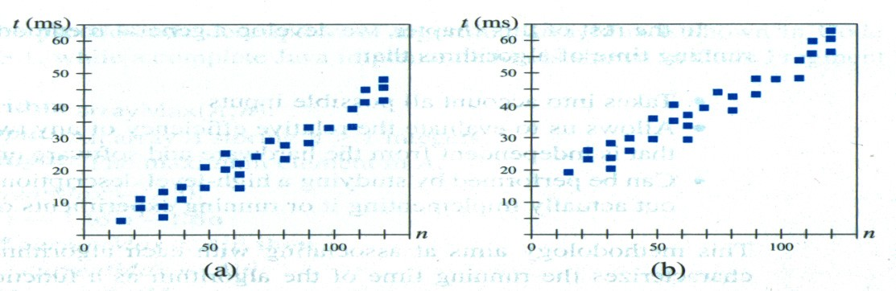
1 Introduction - Efficiency of Algorithms
For example, the following graphs show the execution time, in milliseconds, against sample size, n of a given problem in different computers
The actual running time of a program depends not only on the efficiency of the algorithm, but on many other variables such as Processor speed & type, Operating system, … etc.
More powerful computer

Slide 9
1 Introduction - Running-time of Algorithms
In order to compare algorithm speeds experimentally
All other variables must be kept constant, i.e.
independent of specific implementations (C, C++ or Java),
independent of computers used, and,
independent of the data on which the program runs
Involved a lot of work (better to have some theoretical means of predicting algorithm speed)

Slide 10
Helper function: range(n)
std::vector<int> range(int n)
returns a sequence of numbers from 0 to n – 1 in vector<int>
#include <vector>
#include <iostream>
std::vector<int> range(int n) {
std::vector<int> result;
for (int i = 0; i < n; ++i)
result.push_back(i);
return result;
}
int main() {
for (auto num: range(5))
std::cout << num << " ";
return 0;
}
0 1 2 3 4

Slide 11
Helper function: range(start, stop, step=1)
std::vector<int> range(int start, int stop, int step = 1)
returns a sequence of numbers from start to stop – 1 with step
#include <vector>
#include <iostream>
std::vector<int> range(int start, int stop, int step = 1) {
std::vector<int> result;
if (step > 0) {
for (int i = start; i < stop; i += step)
result.push_back(i);
} else {
for (int i = start; i > stop; i += step)
result.push_back(i);
}
return result;
}

Slide 12
Helper function: ctime_in_sec()
double ctime_in_sec() returns the current time in seconds
#include <iostream>
using namespace std;
using namespace chrono;
double ctime_in_sec() {
auto currentTime = system_clock::now();
auto duration = currentTime.time_since_epoch();
return duration_cast<milliseconds>(duration).count() / 1000.0;
}
int main() {
double startTime = ctime_in_sec();
// your code here
double endTime = ctime_in_sec();
double elapsedTime = endTime - startTime;
cout << "Elapsed time: " << elapsedTime << " seconds" << endl;
return 0;
}

Slide 13
1 Introduction - Example 1
Task:
Complete the sum_of_n() function which calculates the sum of the first n natural numbers.
Arguments: an integer
Returns: the sum of the first n natural numbers
Cases:
sum_of_n(5)
15
sum_of_n(100000)
5000050000

Slide 14




1 Introduction - Algorithm 1
sum_of_n
Set sum = 0
Add each value to sum using a for loop
Return sum
time_start = ctime_in_sec();
sum = 0;
for (auto i: range(n))
sum += ++i;
time_end = ctime_in_sec();
time_taken = time_end - time_start;
The timing calls embedded before and after the summation to calculate the time required for the calculation.

Slide 15
1 Introduction - Algorithm 2
sum_of_n_2
Set sum = 0
Use the equation (n(n + 1))/2, to calculate the total
Return sum
time_start = ctime_in_sec();
sum = n * (n + 1) / 2;
time_end = ctime_in_sec();
time_taken = time_end - time_start;
The timing calls embedded before and after the summation to calculate the time required for the calculation.

Slide 16
1 Introduction - Experimental Result
Using 4 different values for n: [10000, 100000, 1000000, 10000000]
We shall count the number of basic operations of an algorithm and generalize the count.
n | sum_of_n (for loop) | sum_of_n_2 (equation)
10000 | 0.0033 | 0.00000181
100000 | 0.0291 | 0.00000131
1000000 | 0.3045 | 0.00000107
10000000 | 2.7145 | 0.00000123
Time increase as we increase the value of n.
NO impacted by the number of integers being added.
Time Consuming Process!

Slide 17
2 Counting Operations - Example 2A
Example: Calculating the sum of the first 10 elements in the list
Total: 34 operations (steps)
int count1(int *numbers, int n) {
sum = 0;
idx = 0;
while (idx < 10) {
sum += numbers[idx];
idx += 1;
}
return sum;
}
1 assignment
1 assignment
11 comparisons
10 plus/assignments
10 plus/assignments
1 return

Slide 18
2 Counting Operations - Example 2B
Example: Calculating the sum of n elements in the list.
Total: 3n + 4 operations (steps)
We need to measure an algorithm’s time requirement as a function of the problem size, e.g., in the example above the problem size is the number of elements in the list.
int count2(int *numbers, int n) {
sum = 0;
idx = 0;
while (idx < n) {
sum += numbers[idx];
idx += 1;
}
return sum;
}
1 assignment
1 assignment
n + 1 comparisons
n plus/assignments
n plus/assignments
1 return

Slide 19
2 Counting Operations - Problem size
Performance is usually measured by the rate at which the running time increases as the problem size gets bigger,
i.e., we are interested in the relationship between the running time and the problem size.
It is very important that we identify what the problem size is.
For example, if we are analyzing an algorithm that processes a list, the problem size is the size of the list.
In many cases, the problem size will be the value of a variable, where the running time of the program depends on how big that value is.

Slide 20
2 Counting Operations - Exercise 1
How many operations are required to do the following tasks?
Adding an element to the end of a list
Printing each element of a list containing n elements

Slide 21
2 Counting Operations - Exercise 1 solution
How many operations are required to do the following tasks?
Adding an element to the end of a list – one operation, a constant time, or O(1)
Printing each element of a list containing n elements – n operation, or O(n)

Slide 22

2 Counting Operations - Example 3
Consider the following two algorithms:
Algorithm A:
Outer Loop: n operations
Inner Loop: $\frac{n}{5}$ operations
Total: $(n ∗ \frac{n}{5})$ = $\frac{n^{2}}{5}$ operations
Algorithm B:
Outer Loop: n operations
Inner Loop: 5 operations
Total: $(n ∗5) = 5 ∗ n$operations
for (auto i: range(n))
for (auto j: range(0, n, 5))
cout << i << " " << j << endl;
for (auto i: range(n))
for (auto j: range(5))
cout << i << " " << j << endl;

Slide 23
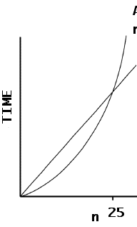

2 Counting Operations - Growth Rate Function – A or B?
Consider the following two algorithms:
Algorithm A: $\frac{n^{2}}{5}$
Algorithm B: $5 ∗ n$
If n is 10⁶ ,
Algorithm A’s time requirement is
$\frac{n^{2}}{5}=\frac{{10}^{12}}{5}={2 ∗ 10}^{11}$
Algorithm B’s time requirement is
$5 ∗n ={5 ∗ 10}^{6}$
What does the growth rate tell us about the running time of the program?
n | 5 | 10 | 15 | 20 | 24 | 25 | 26 | 30
A | 5 | 20 | 45 | 80 | 115 | 125 | 135 | 180
B | 25 | 50 | 75 | 100 | 120 | 125 | 130 | 150
A
B
A is faster when n is a small number

Slide 24
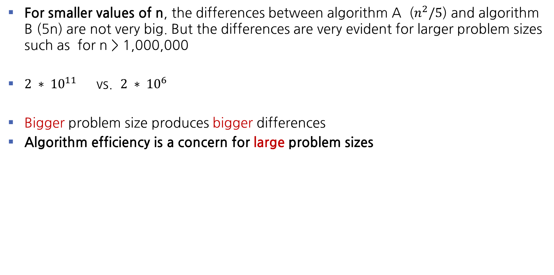
2 Counting Operations - Growth Rate Function – A or B?
For smaller values of n, the differences between algorithm A ($n^{2}/5$) and algorithm B (5n) are not very big. But the differences are very evident for larger problem sizes such as for n > 1,000,000
$2 ∗ {10}^{11}$ vs. $2 ∗ {10}^{6}$
Bigger problem size produces bigger differences
Algorithm efficiency is a concern for large problem sizes

Slide 25
Step Count Exercise Warming-up:
What is the exact number of times sum += 1 executed?
int step(int n) {
sum = 0;
for (auto i: range(n))
sum += 1;
return sum;
}
// Let's suppose it's invoked as follows: cout << step(10);
Useful formulas:
1 + 2 + 3 + … + N = N(N+1)/2
1 + 2 + 4 + 8 + … + 2^{n} = 2^{n+1} – 1

Slide 26
Step Count Exercise Warming-up:
What is the exact number of times sum += 1 executed?
int step(int n) {
sum = 0;
for (auto i: range(n))
sum += 1;
return sum;
}
// Let's suppose it's invoked as follows: cout << step(10);
int step(int n) {
sum = 0;
for (auto i: range(n))
for (auto j: range(n))
sum += 1;
return sum;
}
// Let's suppose it's invoked as follows:
cout << step(10);
Useful formulas:
1 + 2 + 3 + … + N = N(N+1)/2
1 + 2 + 4 + 8 + … + 2^{n} = 2^{n+1} – 1

Slide 27
Step Count Exercise 1:
What is the exact number of times sum += 1 executed?
int step(int n) {
sum = 0;
for (auto i: range(n*n))
for (auto j: range(i+1))
sum += 1;
return sum;
}
// Let's suppose it's invoked as follows:
cout << step(10);
Useful formulas:
1 + 2 + 3 + … + N = N(N+1)/2
1 + 2 + 4 + 8 + … + 2^{n} = 2^{n+1} – 1

Slide 28
Step Count Exercise 2:
What is the exact number of times sum += 1 executed?
int step(int n) {
sum = 0;
while (n > 1) {
sum += 1;
n /= 2;
}
return sum;
}
// Let's suppose it's invoked as follows:
cout << step(128)
Notes:
코드에서 = 를 삭제하면, 오직 n 이 2의 power일 때만 sum = k 이란 것이 성립됩니다. 그 외의 경우는 sum = k가 성립되지 않고, sum + 1 = k해야 합니다.
코드에서 = 를 삭제하지 않으면(PPT 코드), n 이 2의 power일 때는 sum - 1 = k 로 해야 합니다. 그 외의 경우는 sum = k 입니다.
결론적으로, 현재 PPT코드의 = 의 유무로 결정하기보다는 좀 더 나은 예제가 필요한 것 같아요.
다만, 대수적으로 k를 구할 때는, log2(2) = n 보다는 ceiling(log2(n)) = k 가 좀 더 명확한 수식이며, 이 방법은 항상 정확한 step count를 계산할 수 있습니다.

Slide 29
Step Count Exercise 2:
What is the exact number of times sum += 1 executed?
int step(int n) {
sum = 0;
while (n > 1) {
sum += 1;
n /= 2;
}
return sum; }
// Let's suppose it's invoked as follows:
cout << step(128);
We have to find the smallest k
such that n / 2^k = 1
n / 2^k = 1
n = 2^k
log(n) = log(2^k)
log(n) = k
Notes:
코드에서 = 를 삭제하면, 오직 n 이 2의 power일 때만 sum = k 이란 것이 성립됩니다. 그 외의 경우는 sum = k가 성립되지 않고, sum + 1 = k해야 합니다.
코드에서 = 를 삭제하지 않으면(PPT 코드), n 이 2의 power일 때는 sum - 1 = k 로 해야 합니다. 그 외의 경우는 sum = k 입니다.
결론적으로, 현재 PPT코드의 = 의 유무로 결정하기보다는 좀 더 나은 예제가 필요한 것 같아요.
다만, 대수적으로 k를 구할 때는, log2(2) = n 보다는 ceiling(log2(n)) = k 가 좀 더 명확한 수식이며, 이 방법은 항상 정확한 step count를 계산할 수 있습니다.

Slide 30
Step Count Exercise 3:
Compute the following series:
1 + 2 + 3 + … + 9 + 10 =
1 + 2 + 3 + … + (N – 1) + N =
1 + 2 + 4 + … + 16 =
1 + 2 + 4 + … + N =
Compute the following series and express the result in term of N but without log expression. (Hint: N = 2^{logN})
Then use the result and to compute the series shown above in c):
Useful formulas:
1 + 2 + 3 + … + N = N(N+1)/2
1 + 2 + 4 + 8 + … + 2^{n} = 2^{n+1} – 1

Slide 31
Summary
Performance Analysis measure an algorithm’s time requirement as a function of the problem size n by using a growth-rate function.
It is an implementation-independent (including hardware and coded language) way of measuring an algorithm.
Performance(Complexity) analysis focuses on large problems.

Slide 32
프로그램 및 알고리즘의 성능 평가는 시간(time)과 공간(memory, storage)의 측면에서 성능을 비교할 수 있다
문제 크기에 따른 변화율(growth rate)로 알고리즘의 성능을 비교할 수 있다

